Slide 1

Data Science Capstone final Assignment
Author: M. Giaconi

Slide 2
Background
The final assignment has been based on the various techniques learnt and acquired during the 9 modules of the IBM data science professional certification, offered by Coursera

Slide 3


Application
The project work is aimed to an entrepreneur (or a group of them) that would like to make an investment related to Italian cuisine in the city of Toronto.

Slide 4
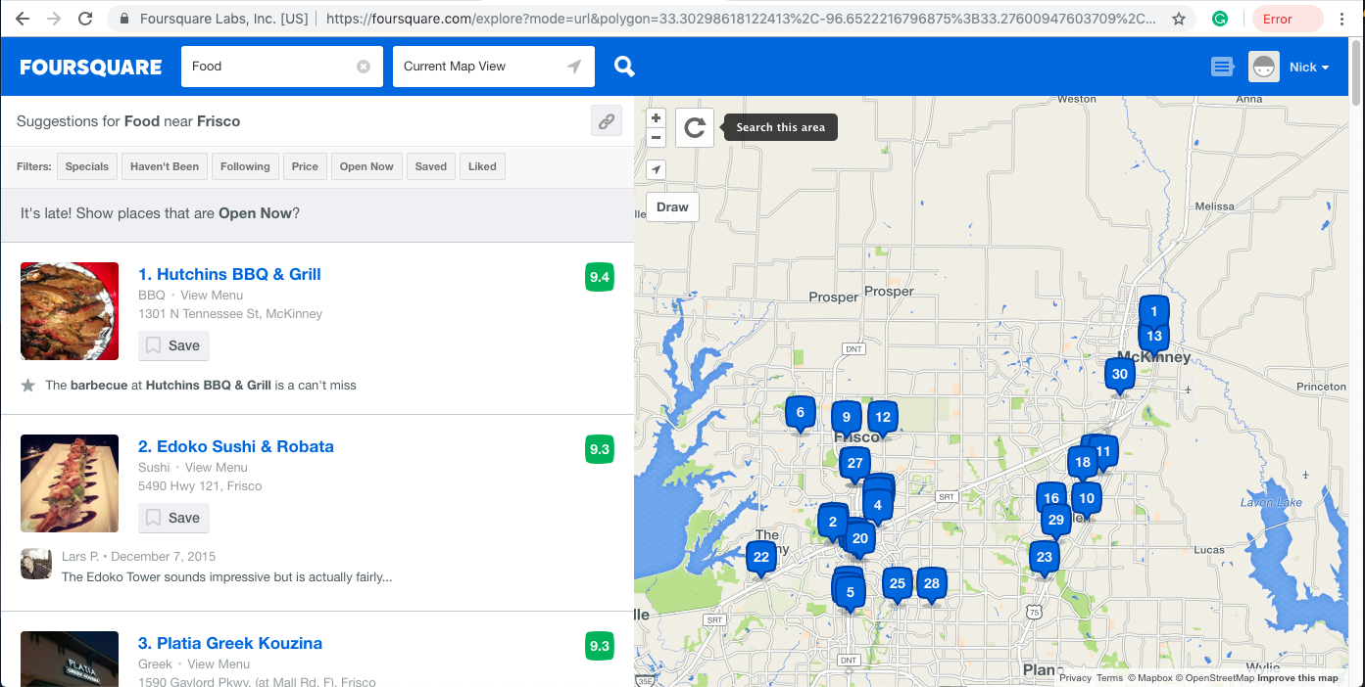
Data
Scrapped from Wikipedia page related to Toronto postal codes (https://en.wikipedia.org/wiki/List_of_postal_codes_of_Canada:_M)
Used Foursquare API to get information related to the public activities located in the surroundings of every neighborhood
Used the Lat and Long of every neighborhood which were provided by Coursera through a CSV file

Slide 5


Methods
Used Python language as main vehicle to build data analysis algorithms
The code has been built on Jupyter Notebooks due to their high flexibility
Libraries include: Folium, Pandas, Numpy, Matplotlib, Kmeans

Slide 6
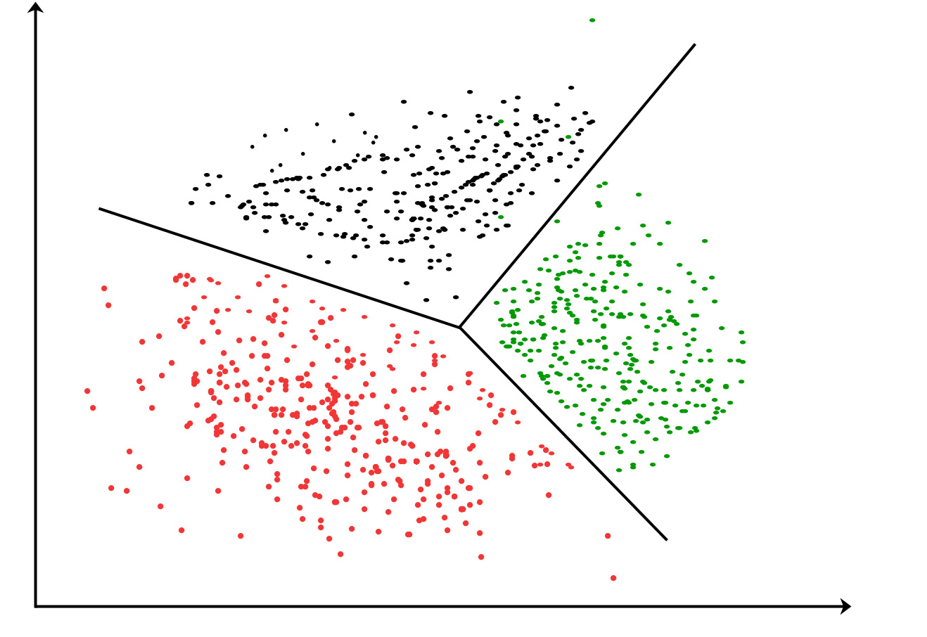
Clusters
Kmeans clustering have been used to process the various data
Indication related to the presence of Italian Restaurants and Pizza places have been used to fit the model
3 Clusters have been built

Slide 7
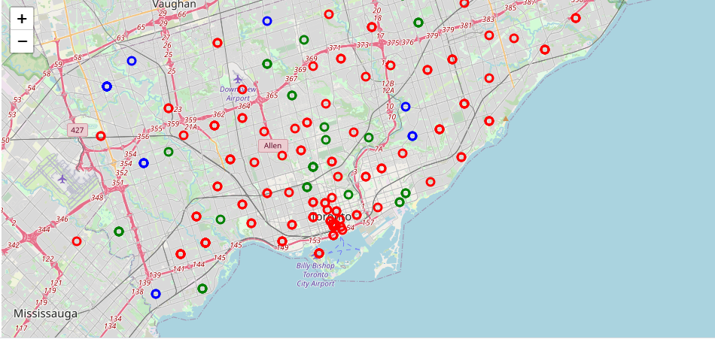
Results
Results are shown in the picture below. The clusters have been colour coded
The final graph clearly shows the separation between the areas nearer to the city centre and those located further away.

Slide 8
Conclusion and further steps
The analysis highlights the difference between neighbourhood in terms of business potentiality.
It would be recommended to integrate the analysis with some data about land usage and costs to make it more reliable and explicative of the possible advantageous areas to build on.

Slide 9
This work is licensed under a Creative Commons Attribution-ShareAlike 3.0 Unported License. It makes use of the works of Mateus Machado Luna.

